Slide 1
Chapter 15
Launching a Successful Online Business and EC Projects

Slide 2
Learning Objectives
Understand the fundamental requirements for initiating an online business.
Describe the process of initiating and funding a startup e-business or large e-project.
Understand the process of adding EC initiatives to an existing business.
Describe the issues and methods of transforming an organization into an e-business.
Describe the process of acquiring websites and evaluate building versus hosting options.

Slide 3
Learning Objectives
Understand the importance of providing and managing content and describe how to accomplish this.
Evaluate websites on design criteria, such as appearance, navigation, consistency, and performance.
Understand how search engine optimization may help a website obtain high placement in search engines.
Understand how to provide some support e-services.
Understand the process of building a webstore.
Know how to build a webstore with templates.

Slide 4
Getting into E-Commerce and Starting a New Online Business
GETTING INTO E-COMMERCE
STARTING A NEW ONLINE BUSINESS
AN E-STARTUP IS A STARTUP
CREATING A NEW COMPANY OR ADDING AN ONLINE PROJECT
Identify a consumer or business need in the marketplace.
Investigate the opportunity.
Determine the business owner’s ability to meet the need.

Slide 5
Getting into E-Commerce and Starting a New Online Business
Some Tips for Success
Do your homework.
Aim for excitement.
Whittle, shape, iterate, repeat.
Get real.
Avoid creating a gizmo.
Cloning

Slide 6
Getting into E-Commerce and Starting a New Online Business
PLANNING ONLINE BUSINESSES
business plan
A written document that identifies a company’s goals and outlines how the company intends to achieve the goals and at what cost
business case
A document that justifies the investment of internal, organizational resources in a specific application or project

Slide 7
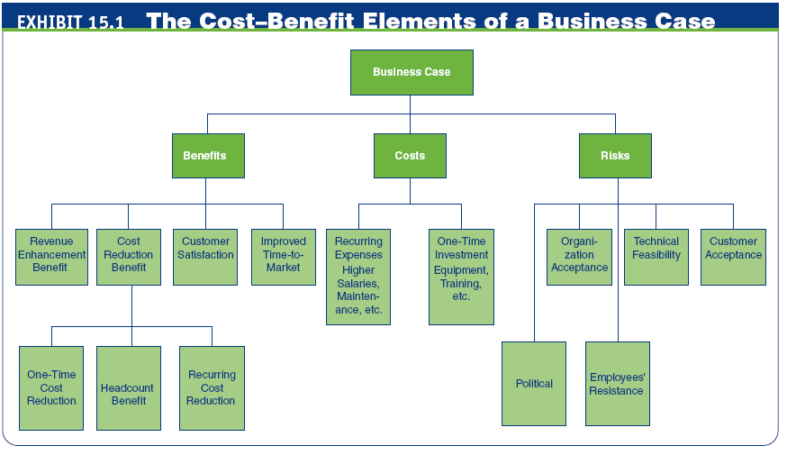

Slide 8
Getting into E-Commerce and Starting a New Online Business
FUNDING A NEW ONLINE BUSINESS
First Round of Initial Funding
angel investor
A wealthy individual who contributes personal funds and possibly expertise at the earliest stage of business development
incubator
A company, university, or nonprofit organization that supports businesses in their initial stages of development

Slide 9
Getting into E-Commerce and Starting a New Online Business
Second Round Fina
venture capital (VC)
Money invested in a business by an individual, a group of individuals (venture capitalists), or a funding company in exchange for equity in the business
Additional Funding: A Large Partner
The Initial Public Offer (IPO)

Slide 10
Adding E-Commerce Initiatives or Transforming to an E-Business
ADDING EC INITIATIVES TO AN EXISTING BUSINESS
A webstore
A portal
E-procurement
Auctions and reverse auctions
M-commerce
Social commerce

Slide 11
Adding E-Commerce Initiatives or Transforming to an E-Business
TRANSFORMATION TO AN E-BUSINESS
What Is Organizational Transformation?
How an Organization Can Be Transformed into an E-Business
Business Process Reengineering (BPR)

Slide 12
Adding E-Commerce Initiatives or Transforming to an E-Business
business process management (BPM)
Method for business restructuring that combines workflow systems and redesign methods; covers three process categories—people-to-people, systems-to-systems, and systems-to-people interactions
Software Tools for Facilitating the Transformation to E-Business
Change Management

Slide 13
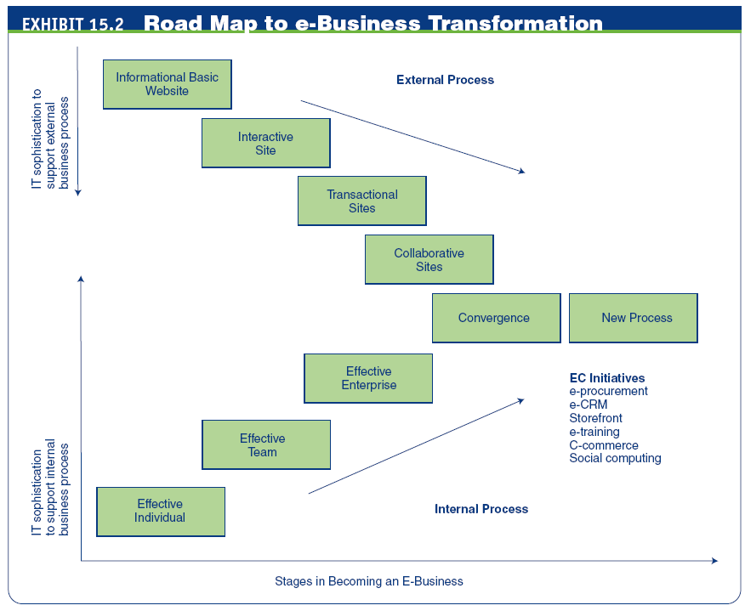

Slide 14
Building or Acquiring a Website
CLASSIFICATION OF WEBSITES
informational website
A website that does little more than provide information about the business and its products and services
interactive website
A website that provides opportunities for the customers and the business to communicate and share information
attractors
Website features that attract and interact with visitors in the target stakeholder group

Slide 15
Building or Acquiring a Website
transactional website
A website that sells products and services
collaborative website
A site that allows business partners to collaborate
social-oriented website
A site that provides users online tools for communication and sharing information on common interests

Slide 16
Building or Acquiring a Website
BUILDING A WEBSITE
Steps in Building a Website
Select a Web host.
Register a domain name.
Create and manage content.
Design the website.
Construct and test the website.
Market and promote the website.

Slide 17
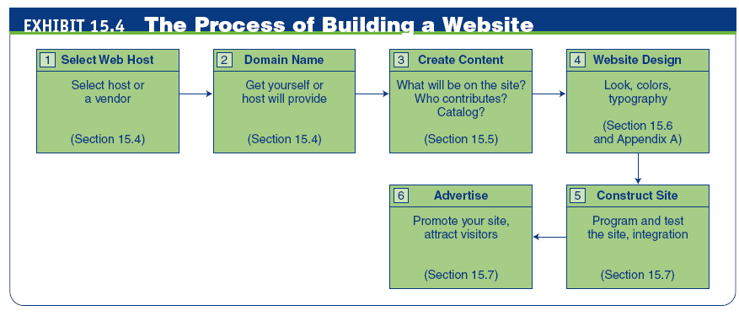

Slide 18
Website Hosting and Obtaining a Domain Name
WEB HOSTING OPTIONS
storebuilder service
A hosting service that provides disk space and services to help small and microbusinesses build a website quickly and cheaply
A Dedicated Hosting Service
Web hosting service
A dedicated website hosting company that offers a wide range of hosting services and functionality to businesses of all sizes
mirror site
An exact duplicate of an original website that is physically located on a Web server on another continent or in another country

Slide 19
Website Hosting and Obtaining a Domain Name
ISP Hosting Combined with Web Designer
ISP hosting service
A hosting service that provides an independent, stand-alone website for small and medium-sized businesses
self-hosting
When a business acquires the hardware, software, staff, and dedicated telecommunications services necessary to set up and manage its own website

Slide 20
Website Hosting and Obtaining a Domain Name
REGISTERING A DOMAIN NAME
domain name
A name-based address that identifies an Internet-connected server; usually it refers to the portion of the address to the left of .com and .org, etc.
Domain Name System (DNS)
A hierarchical naming system for computers, services, or any resource participating in the Internet; it is like a directory

Slide 21
Content Creation, Delivery, and Management
content
The text, images, sound, and video that make up a Web page
CATEGORIES AND TYPES OF CONTENT
dynamic Web content
Content that must be kept up-to-date

Slide 22
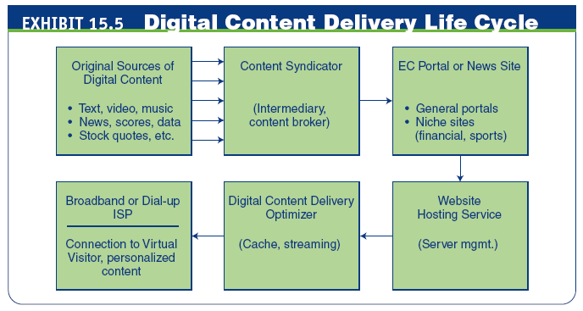

Slide 23
Content Creation, Delivery, and Management
Primary and Secondary Content
cross-selling
Offering similar or complementary products and services to increase sales
up-selling
Offering an upgraded version of the product in order to boost sales and profit
Promotion
Comment

Slide 24
Content Creation, Delivery, and Management
CREATION OR ACQUISITION OF CONTENT
Buying Content
syndication
The sale of the same good (e.g., digital content) to many customers, who then integrate it with other offerings and resell it or give it away free
Web syndication
A form of syndication in which a section of a website is available for other sites to use

Slide 25
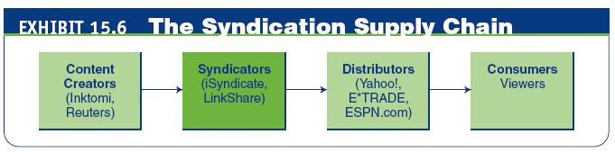
Content Creation, Delivery, and Management
Really Simple Syndication (RSS)
A family of Web-feed formats used to publish frequently updated digital content

Slide 26
Content Creation, Delivery, and Management
podcast
A media file that is distributed over the Internet using syndication feeds for playback on mobile devices and personal computers; as with the term radio, it can mean both the content and the method of syndication
A collection of audio files in MP3 format
Representative Content-Related Vendors
Content Delivery Networks

Slide 27
Content Creation, Delivery, and Management
personalized content
Web content that matches the needs and expectations of the individual visitor
e-newsletter
A collection of short, informative articles sent at regular intervals by e-mail to individuals who have an interest in the newsletter’s topic

Slide 28
Content Creation, Delivery, and Management
content management
The process of adding, revising, and removing content from a website to keep content fresh, accurate, compelling, and credible
Content Testing and Updating
Measuring Content Quality
Pitfalls of Content Management
Content Removal
Content Management Software

Slide 29
Content Creation, Delivery, and Management
CATALOG CONTENT AND ITS MANAGEMENT
CONTENT MAXIMIZATION AND STREAMING SERVICES
Content for Large EC Sites

Slide 30
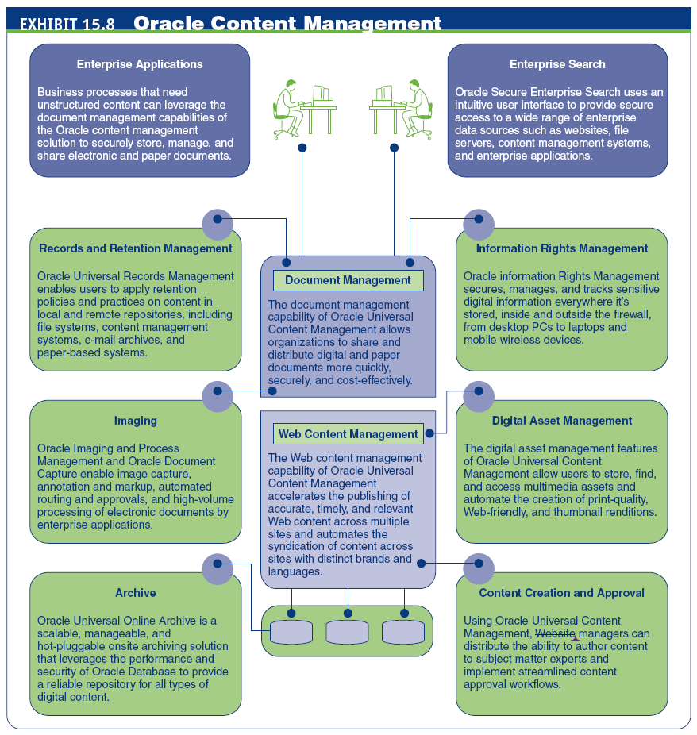

Slide 31
Website Design
Guidelines for a successful Website:
Build it for users (useful for the user, not necessarily the company).
Make it useful (e.g., usability test).
Make information easy to find.
Accommodate all users, including those with disabilities.
Build a comprehensive, responsive, and effective site.

Slide 32
Website Design
Measure the site against the best of its peer group.
Build trust; be up front about security, privacy, and marketing policies.
Assign ownership to users, but work as a team with the technical people.
Set priorities; do the most beneficial stuff first.
Watch for new developments and encourage innovation.

Slide 33
Website Design
information architecture
How the site and its Web pages are organized, labeled, and navigated to support browsing and searching throughout the website

Slide 34
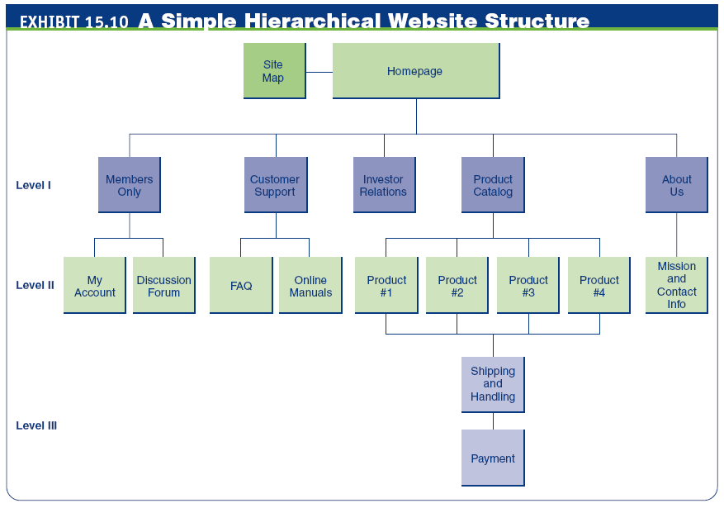

Slide 35
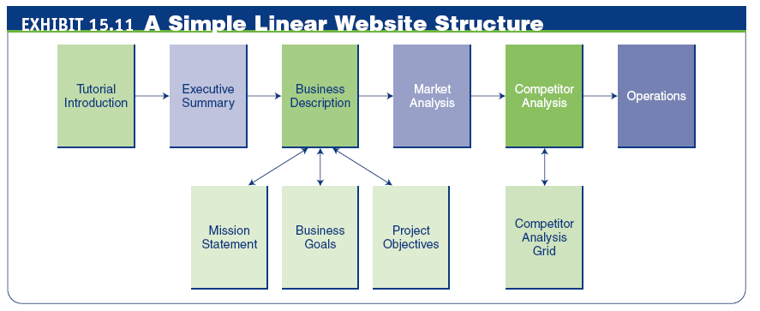

Slide 36

Website Design
SITE NAVIGATION
site navigation
Aids that help visitors find the information they need quickly and easily
Site Map and Navigation

Slide 37
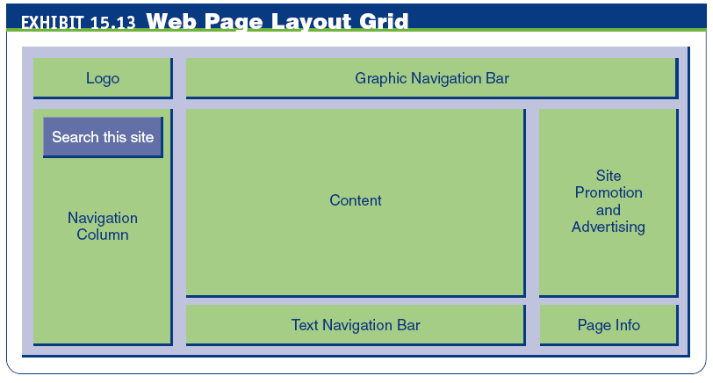

Slide 38
Website Design
PERFORMANCE (SPEED)
COLORS AND GRAPHICS
usability (of website)
The quality and usefulness of the user’s experience when interacting with the website
What Annoys EC Customers?

Slide 39
Providing E-Commerce Support Services
WHO BUILDS THE WEBSITE?
PAYMENTS: ACCEPTING CREDIT CARDS
card-not-present (CNP) transaction
A credit card transaction in which the merchant does not verify the customer’s signature

Slide 40
Providing E-Commerce Support Services
WEBSITE PROMOTION
Internal Website Promotion
signature file
A simple text message an e-mail program automatically adds to outgoing messages
Web analytics
The measurement, collection, analysis, and reporting of Internet data for the purposes of understanding and optimizing Web usage

Slide 41
Providing E-Commerce Support Services
search engine optimization (SEO)
The application of strategies intended to position a website at the top of Web search engines
CUSTOMER RELATIONSHIP MANAGEMENT
Using Content to Build Customer Relationships

Slide 42
Opening a Webstore
OPTIONS FOR ACQUIRING WEBSTORES
Build them from scratch
Build them from components
Build with templates (storebuilders)

Slide 43
Opening a Webstore
Selecting a Development Option. Consider:
Customers
Merchandising
Sales service
Promotion
Transaction processing
Marketing data and analysis
Branding

Slide 44
Opening a Webstore
YAHOO! SMALL BUSINESS
Getting Started
Take a Tour and See the Videos
Using the Templates

Slide 45
Managerial Issues
What does it take to create a successful online business?
Is creating a website a technical task or a management task?
How do we attract visitors to the website?
How do we turn visitors into buyers?
Are best practices useful?
What should my new business give to funders?
What are important factors for successful Web management?

Slide 46
Summary
Fundamental requirements for initiating an online business
Funding options for a startup online business
Adding e-initiatives
Transformation to e-business
Website hosting options for an online business

Slide 47
Summary
Provide content that attracts and keeps website visitors.
Design a visitor-friendly site.
High placement in search engines is key.
Provision of support services.
The process of building a webstore.
Using templates to build a webstore.

Slide 48
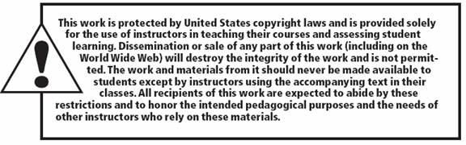
All rights reserved. No part of this publication may be reproduced, stored in a retrieval system, or transmitted, in any form or by any means, electronic, mechanical, photocopying, recording, or otherwise, without the prior written permission of the publisher. Printed in the United States of America.
Copyright © 2012 Pearson Education, Inc.
Publishing as Prentice Hall

